Slide 1
BDA204 Individual Project Presentation
Carlos Sek
June 15, 2020

Slide 2
PROJECT SUMMARY
Topic about my life – what’s important ?
How my data was collected ?
Visualize the data
Findings through observation and discovery
Insight
Conclusion / Suggested Actions
Suggested Future Research.

Slide 3


TOPIC
Topic : How was my daily routine impacted during the COVID-19 pandemic.
Goal of this data analysis through visualization is to help delivering an informative and persuasive “message” and to provide a positive emotional impact to my own life style.
Objective : Through visualization, I am hoping to draw some insights on the collected data by discovering new trends.
Due to the COVID-19 pandemic, which requires us to stay home as much as possible, the topic was inspired to see how it impacts my daily routine.
1
Why this topic?
What kind of data was collected?
Over 70 data points were collected on hours spent in sleeping; meal; exercising; social media; YouTube watching sports, food, travel, shopping; video gaming, movie, schooling, etc
2
How was the data collected?
Google Calendar to track;
Excel spreadsheet to collect
3
What was the Time Period of the study?
Data was collected in between May11 to Jun14, so 5 weeks.
4

Slide 4
TOOLS
What tools were chosen and why?
Excel – use for input data because it is easy to use
Challenges and lesson learned.
Need to be disciplined in keeping up with data recording daily.
Tableau – great visual tools on collected data; wanted to expose and deep learning it
Need to take initiative to self-learning on Tableau.

Slide 5
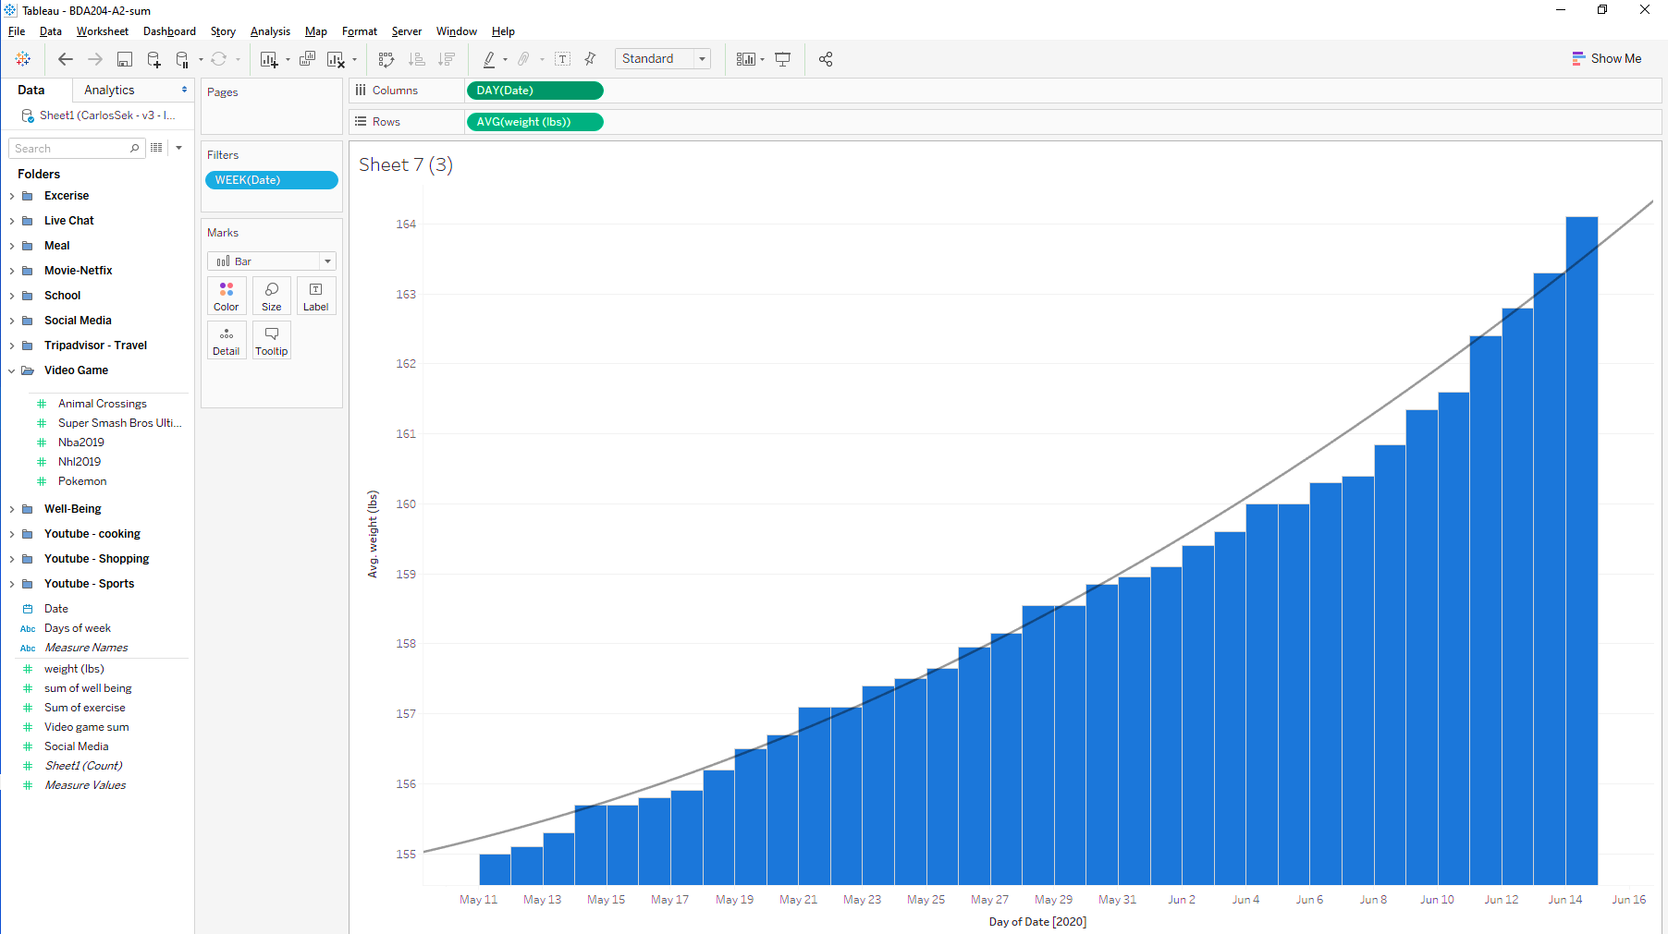
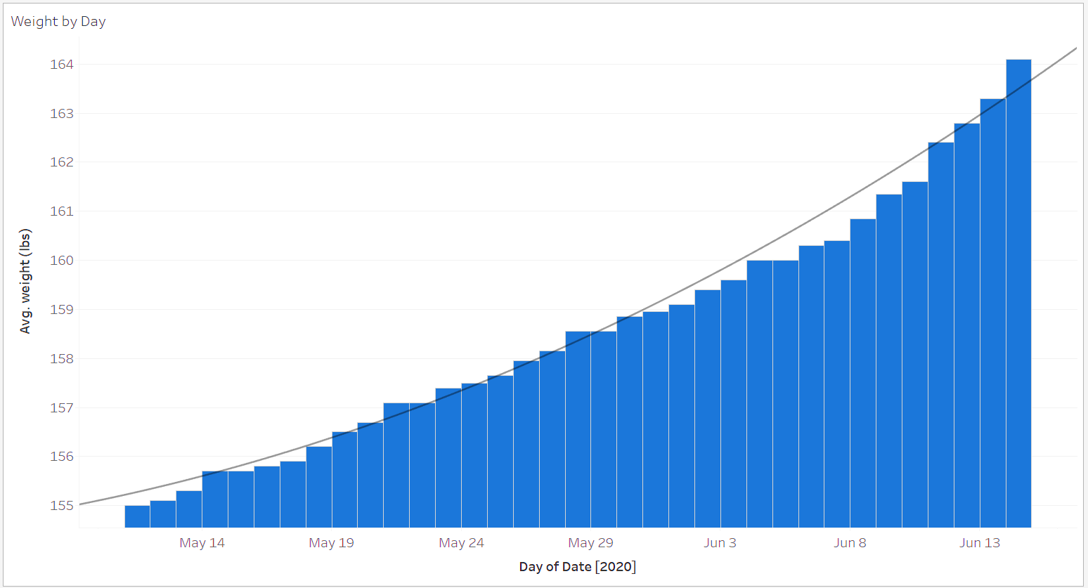
What’s the obvious change that I care the most? Weight gain?
Data points grouped by Folders imported from xls spreadsheet
E.g. Various games under Video Game Folder
Weight change (lbs) during Pandemic period between May 11 to June 14
Notes:
- Talk about the Tableau where on the LEFT, lots of data points organized by FOLDERS. Expanded Video Game FOLDER, you can see the breakdown of each elements, which is the name of games I played (Animal Crossings-everyone playing in the world, Super Smash Bros Ultimate, Nba2019, HNL2019, Pokemon Go)
During the period, I have gained 10 lbs ! Something went wrong that prompts me to study how I spent my time that may have caused the change in weight by adding 10 lbs.
Bar graph used to show the incremental changes + Line graph to show the trend during the period, which is an upward trending.

Slide 6
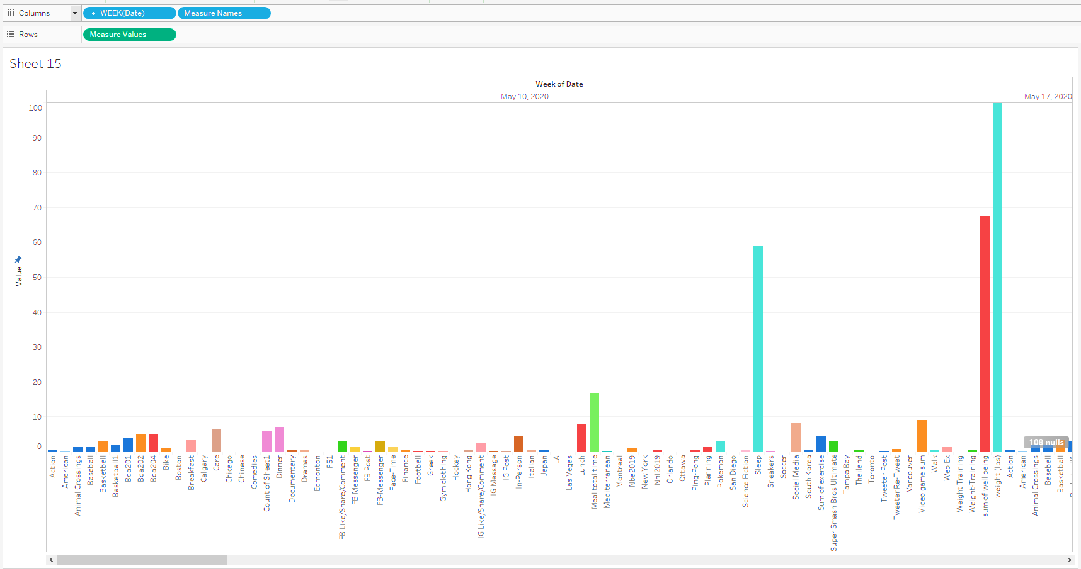
What’s causing my weight gain ? All data points at a glance
Carlos’s time spent per data point in a week
data points imported from xls spreadsheet
- Too many, too small, hard to read
Notes:
As you can see, over 70 data points on the same graph, it is too crowded and very hard to read !
It does not make any sense if we rank it because they are on different scale, for example, weight in lbs vs sleep time in hrs, not comparable though
So we need to deep dive in more details by grouping the similar elements together

Slide 7
What’s causing my weight gain ?
1
Did I eat too much?
2
Did I play too much video game?
3
Did I spend too much time in social media?
4
Did I exercise enough?
Notes:
So Questions came to my mind are: 1) did I eat too much 2) did I play too much video game 3) did I spent too much time on social media 4) did I exercise enough ……which means did I sit too long and lack of exercise, if so, what’s making me sit a lot?
These quesiton will breakdown into 3 graphs that will be gone through pretty easily

Slide 8
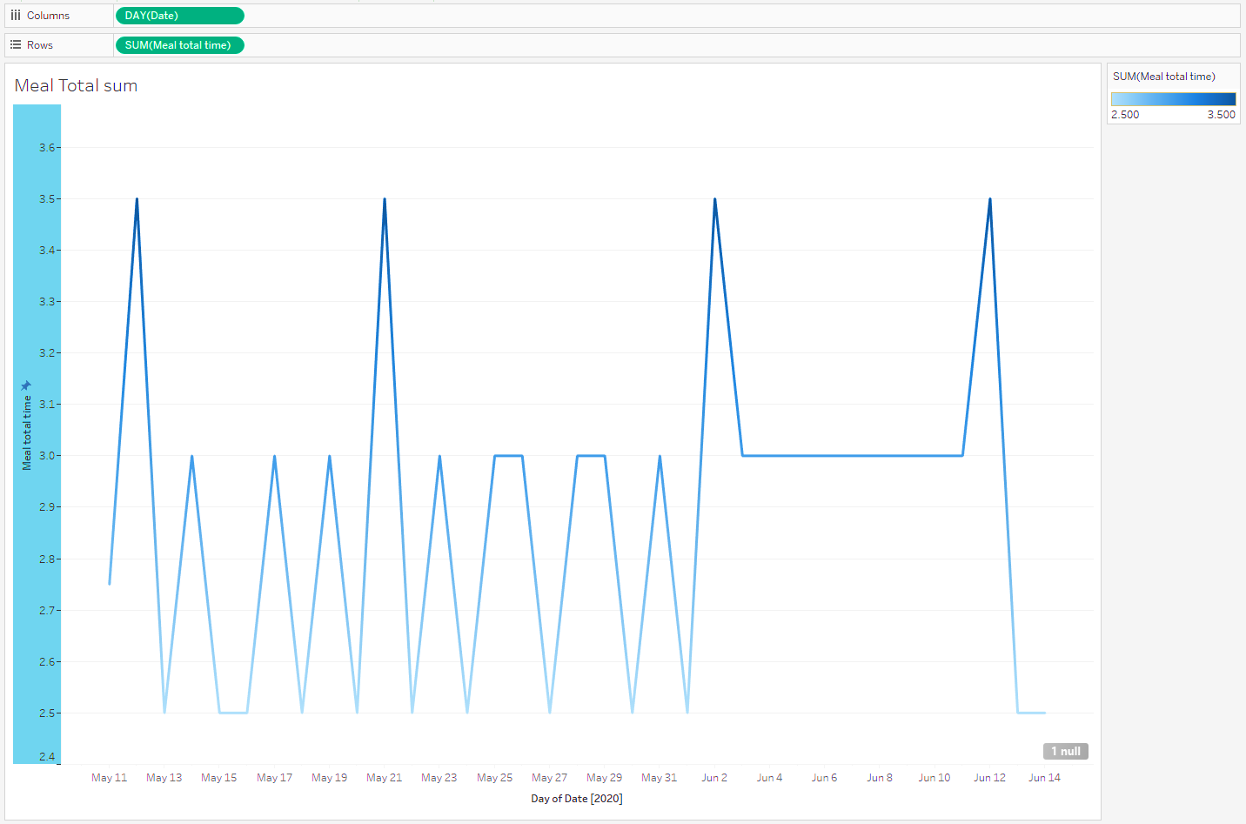
What’s causing my weight gain ? Q1: Spent too much time in meal ?
Meal time Trend of sum of ALL types
spiking
Notes:
Questions came to my mind are: 1) did I eat too much
I can see some spikes with eating more

Slide 9
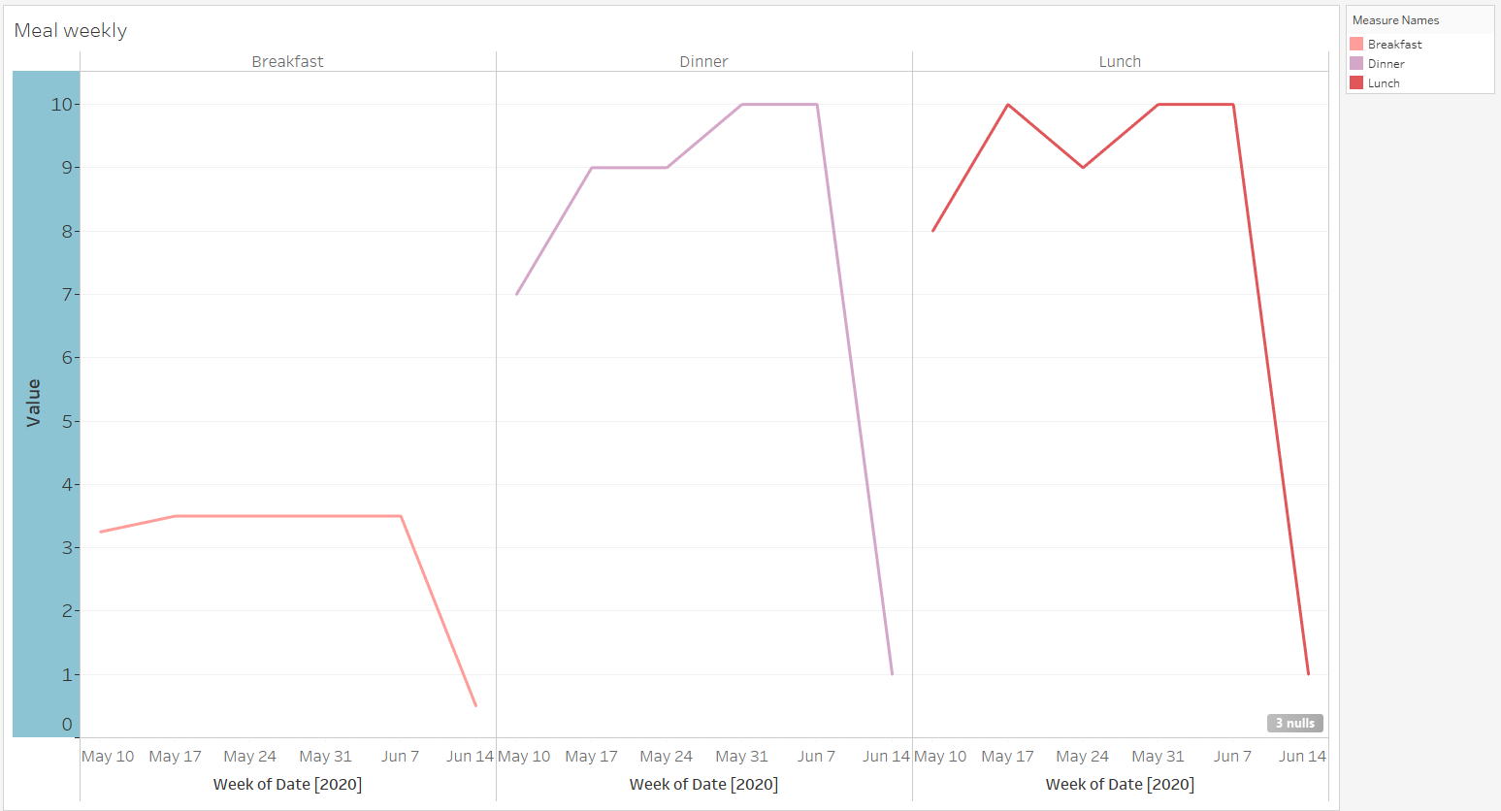
What’s causing my weight gain ? Q1: Spent too much time in meal ?
Meal time hrs spent Weekly by types
Notes:
- Once I break down the meal time, I can see all the types: lunch, dinner are the most
- trend goes up from beginning of the period but finally I was able to wind down

Slide 10
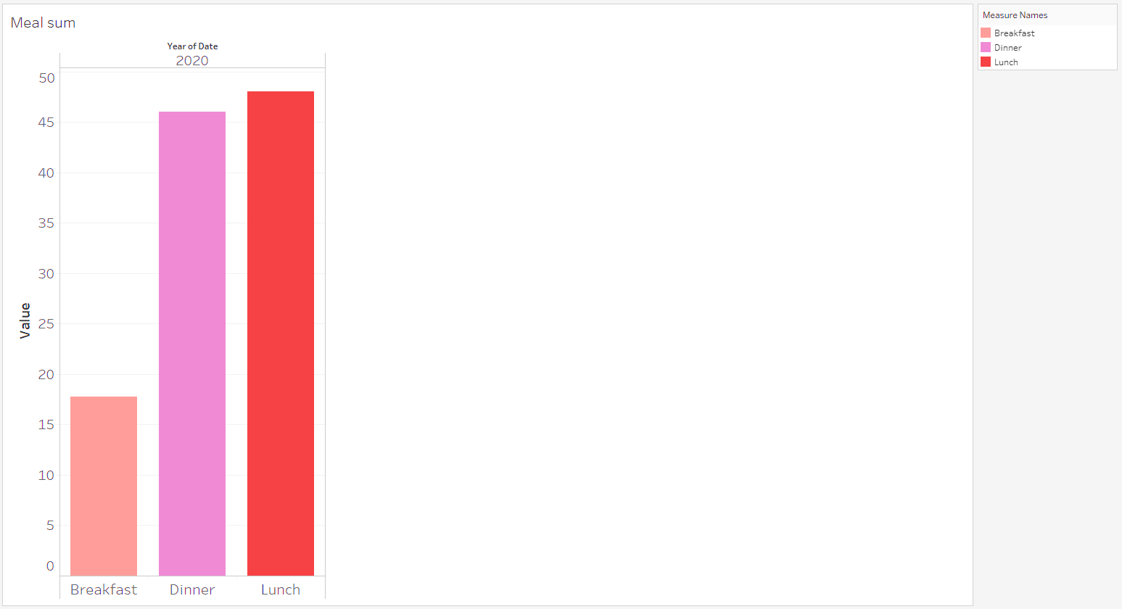
What’s causing my weight gain ? Q1: Spent too much time in meal ?
Meal time total hrs spent by types
Notes:
Another way to look at it is to see the break down comparing across all kinds of Meal time in TOTAL over the period.
In the breakdown of Meal time, I can see :
Lunch, Dinner are the most followed in the period

Slide 11
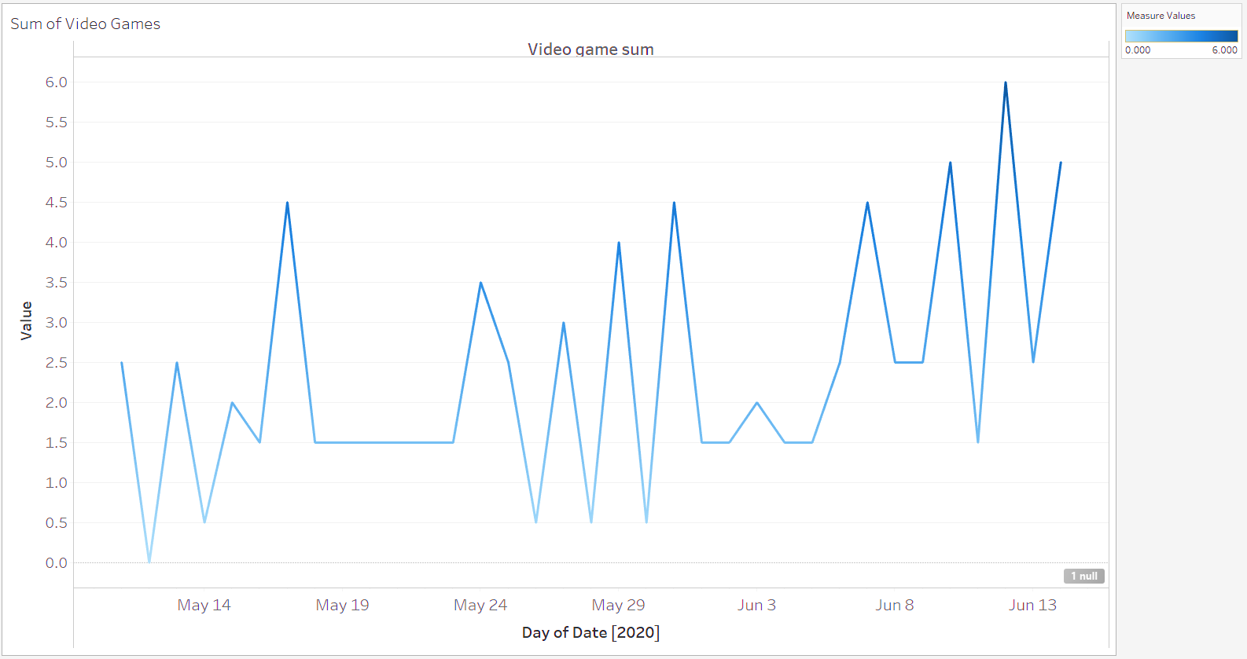
What’s causing my weight gain ? Q2: Too much video game ?
Video game Trend of sum of ALL types
spiking
Notes:
During break time, since there is no gym open, no movie theatre open, no social gathering, one of the alternative is to play video game with friends on internet. Thus I sit down more than getting up and move around between places.
- Trend up

Slide 12
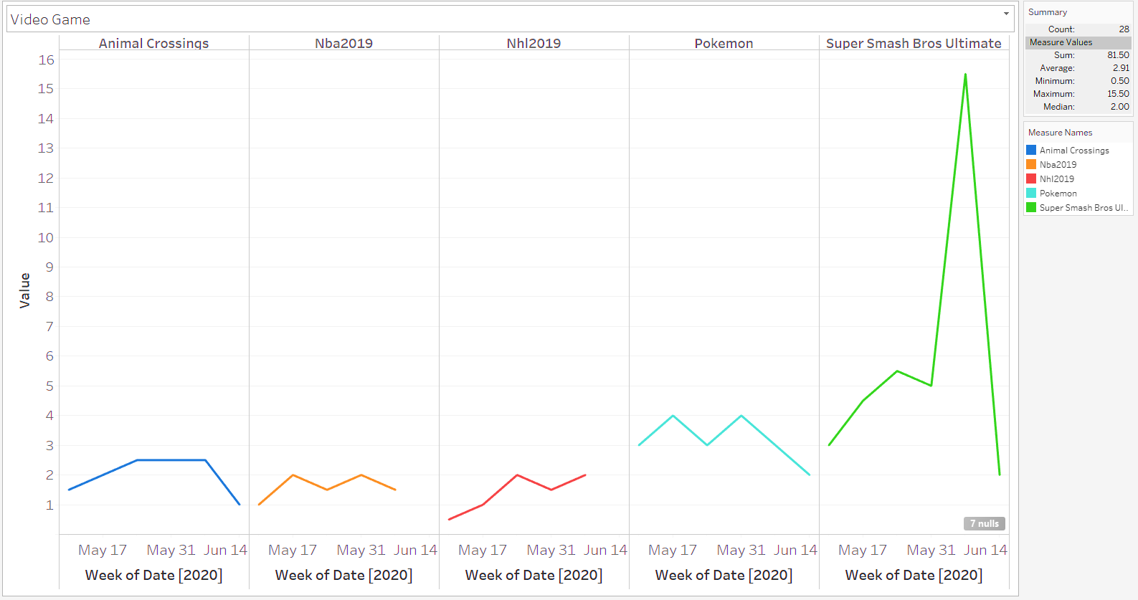
What’s causing my weight gain ? Q2: Is it too much video game?
Video game hrs spent Weekly by types
Notes:
- Once I break down the video game, I can see all the types: Animal Crossings, Nba2019, NHL2019, Pokemon, Super Smash Bros Ultimate is the most
- trend goes up from beginning of the period but finally I was able to wind down

Slide 13
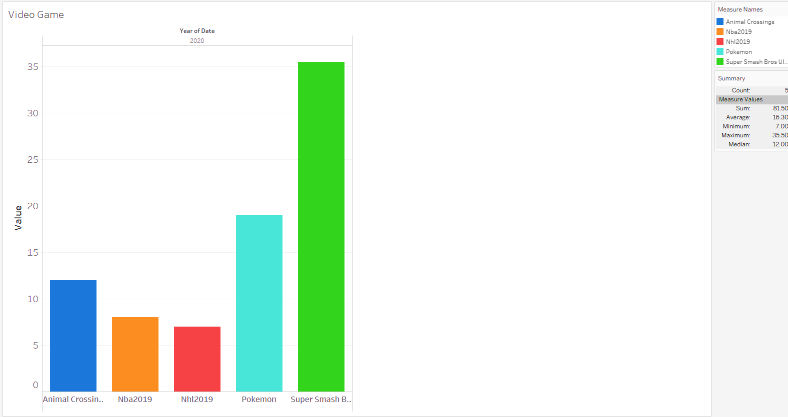
What’s causing my weight gain ? Q2: Is it too much video game?
Video Game total hrs spent by types
Notes:
Another way to look at it is to see the break down comparing across all kinds of Video Game in TOTAL over the period.
In the breakdown of Video Game, I can see :
Super Smash Bros. Ultimate the most followed by Pokemon Go hrs spent in the period

Slide 14
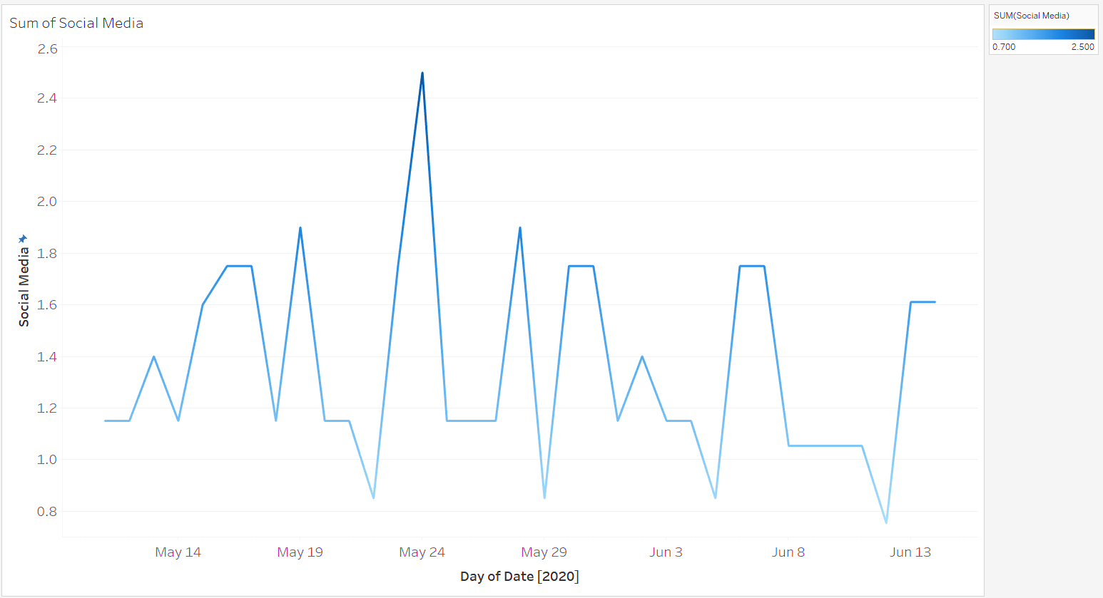
What’s causing my weight gain ? Q3: Too much social media?
Social Media Trend of sum of ALL types
spiking
Notes:
- Due to lack of in-person interactions, the alternative is to do online video chat, text messaging on FB, Tweeter, follow friends on FB, IG etc
trend up more than down/low, with some a lot of spike.
However, I need to drill in deeper to discover what my trends are like as I may have spent too much time on social media

Slide 15
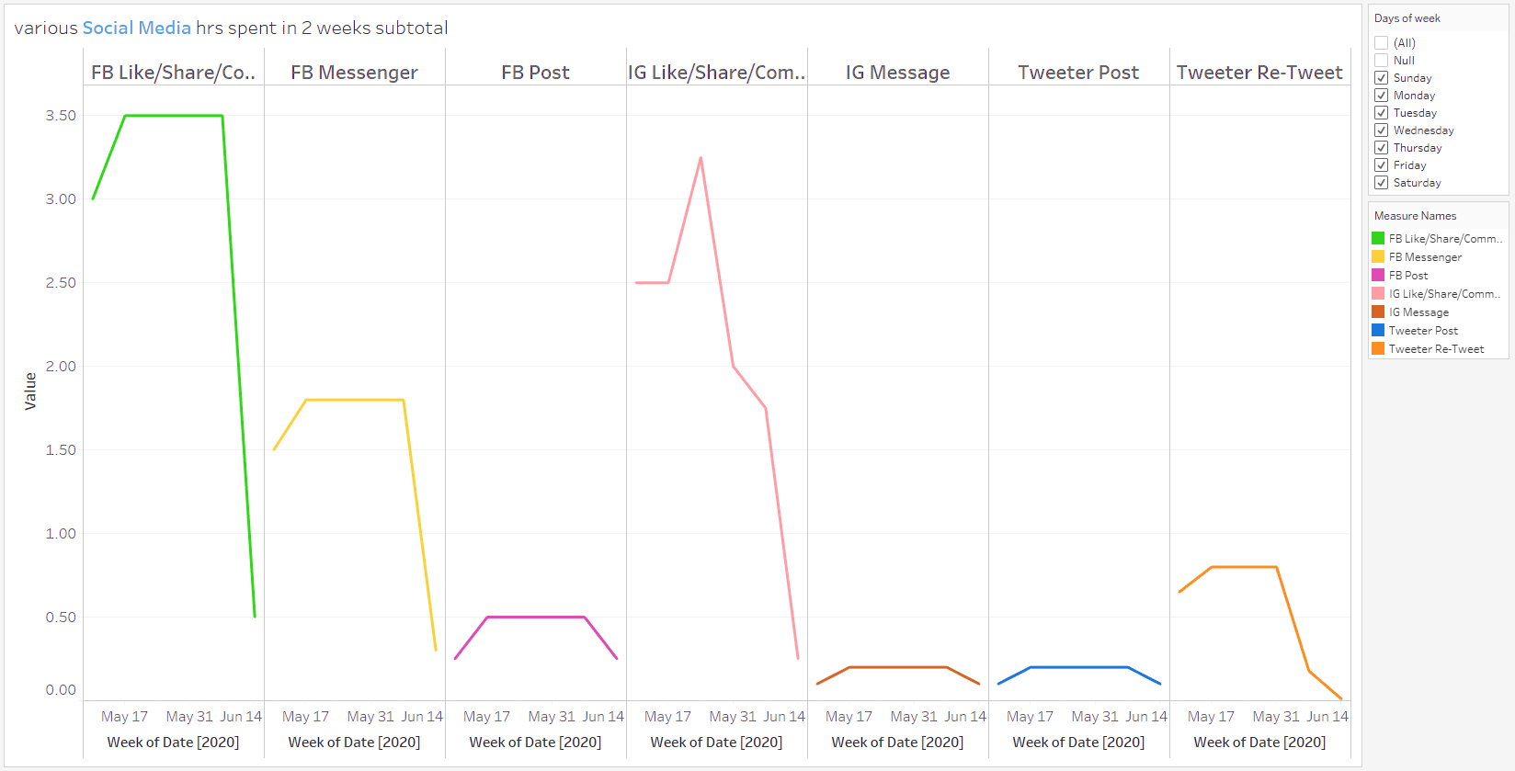
What’s causing my weight gain ? Q3: Too much social media?
Social Media hrs spent Weekly by types
Notes:
- Once I break down the social media, I can see all the types: FB(Like/Share/Comment); FB Messenger; FB Post; IG (Like/Share/Comment); IG Message; Tweeter Post; Tweeter Re-Tweet.
- trend goes up from beginning of the period but finally I was able to wind down

Slide 16
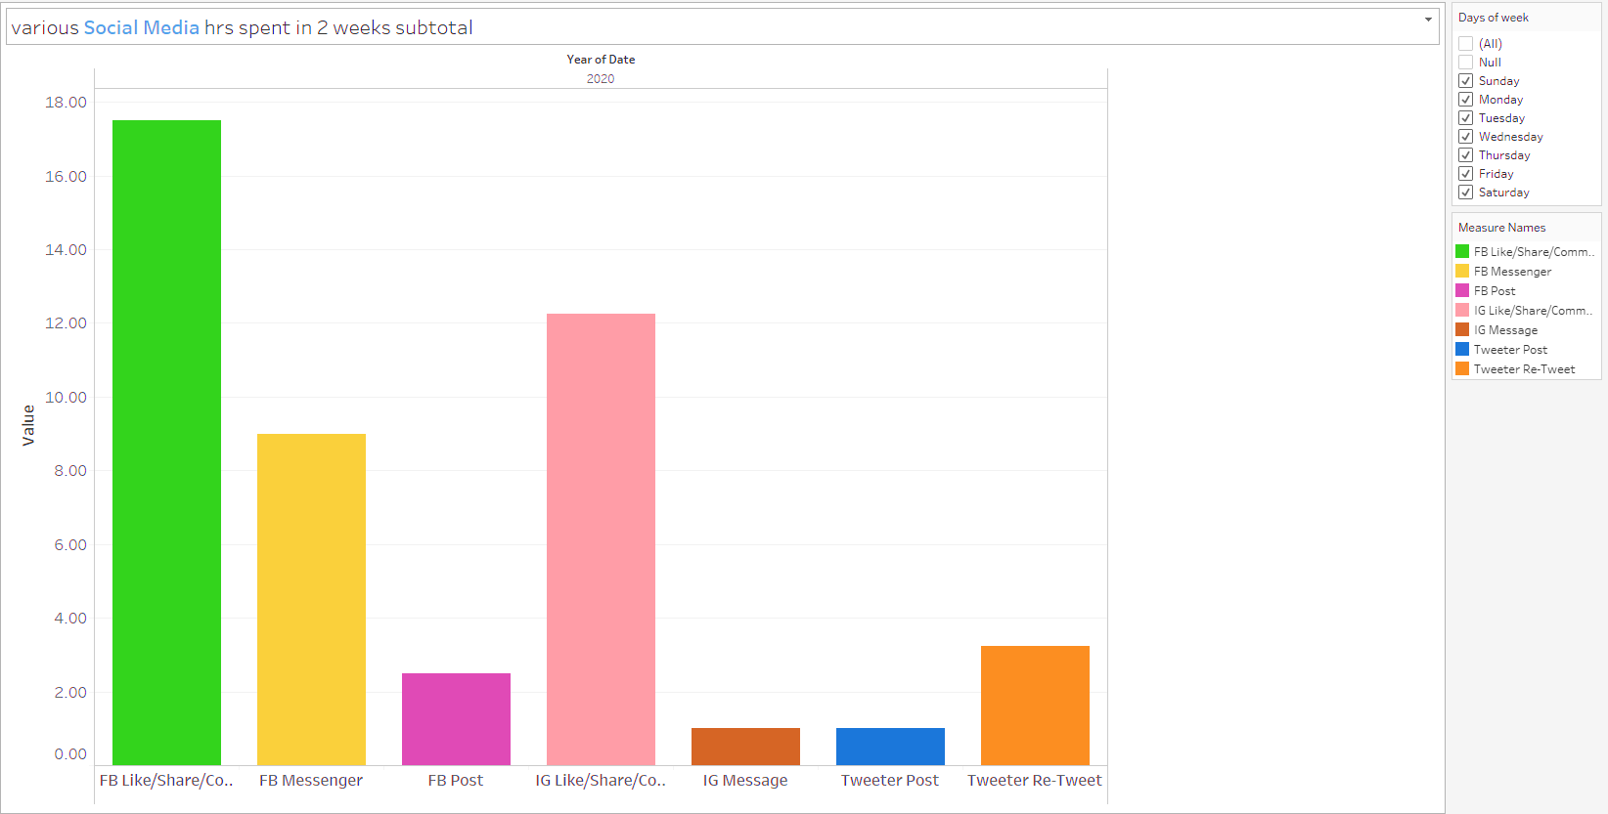
What’s causing my weight gain ? Q3: Too much social media?
Social Media total hrs spent by types
Notes:
Another way to look at it is to see the break down comparing across all kinds of social media in TOTAL over the period.
In the breakdown of Social Media, I can see :
FB & IG are the most hrs spent in the period

Slide 17
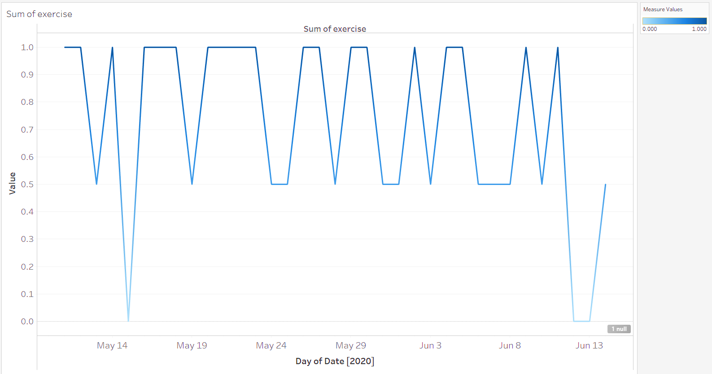
What’s causing my weight gain ? Q4: Too little exercise?
Exercise Trend of sum of ALL types
dropping
Notes:
Wondering if am I continuously muscle building and not burning fat as before the pandemic I would work out more often than now
- I can see my exercise drop and back up , not so consistent

Slide 18
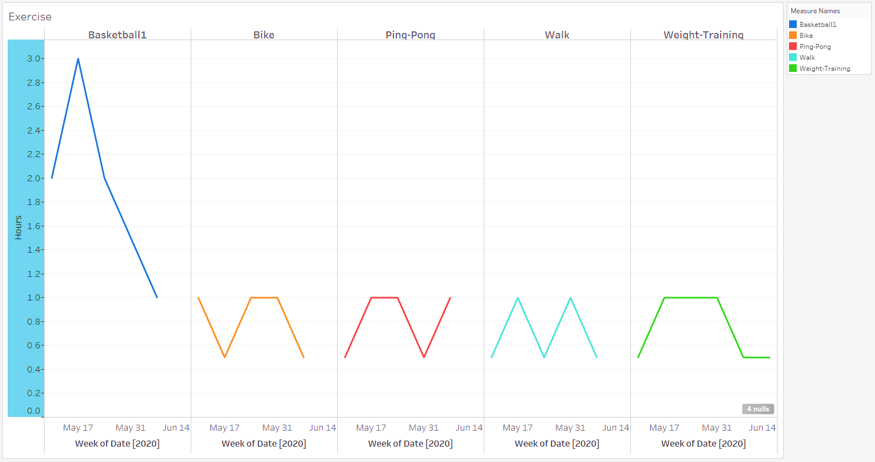
What’s causing my weight gain ? Q4: Too little exercise?
Exercise hrs spent Weekly by types
Notes:
- Once I break down the exercise, I can see all the types: Basketball, Bike, Ping-ping, Walk, Weight-Training
Basketball appears to drop the most and that time goes social media and video games

Slide 19
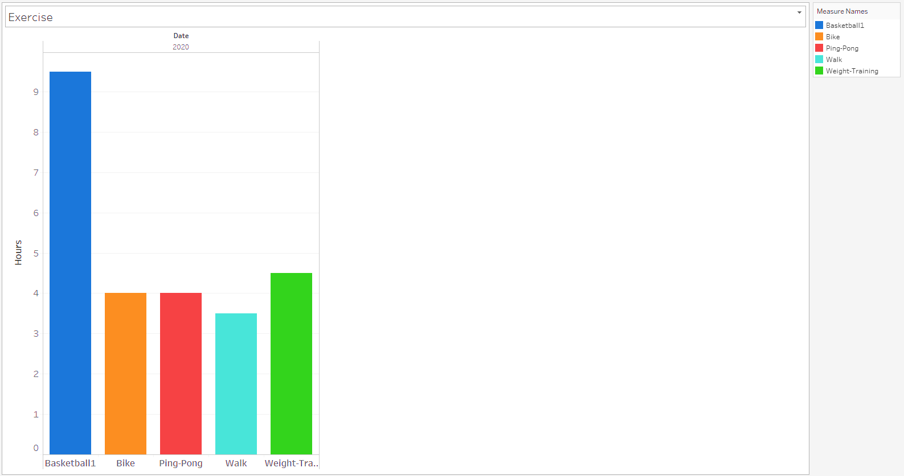
What’s causing my weight gain ? Q4: Too little exercise?
Exercise total hrs spent by types
Notes:
Another way to look at it is to see the break down comparing across all kinds of exercise in TOTAL over the period.
In the breakdown of Exercise, I can see :
Baseket Ball is the most hrs spent in the period followed by weight-training

Slide 20



Summary - Comparison of Social Media, Video Game, Exercise
Notes:
Social Media (FB Like/Share/Comment), Video Game (Pokemon, Super Smash Bros Ultimate), Exercise (Basketball)
Are the most to look at to reduce to improve well-being such that my weight gain can be under control.
Please note I have 3 different scales
Ssbu I spend way too much time as I spent 4 times more than amount spend on bball as this game is way too addicting for me and its too fun to play with friends since I don’t see them in person very often

Slide 21
Insight
During break time …..
Video Game: A lot of hrs total spent on Pokemon , Super Smash Bros Ultimate, animal crossing, which cause late sleeping time or less hrs in sleep.
Exercise: Basketball hrs went down as I spent more time on video games, should spend more time in weight lifting
I tend to get bored at home very often and not taking care of keeping my body in shape spending most hours in front of a screen
Social Media: A lot of hours total spent on Facebook and IG, should lower total hrs
Meal time: more time in eating, which becomes a factor in gaining weight

Slide 22
Action / Future
Actions for myself…..
Future study if I can ….
Increase time spending in person-to-person interaction instead of Social Media (FB/IG)
Well-being balance by increasing more in exercising and cut down on social media/internet and video games.
Do not spend more time in eating / sitting, exercise and sleep more !
In the future, if given the chance to further study this topic, I would suggest to obtain a sample size of 30 or more people in order to be sufficient to be normally distributed.
Secondly, another research topic could be conducted to correlate my findings is to obtain another dataset from Ministry of Health for my age group around the same period of time whose is seeking medical helps. Thus predictive analysis could be performed by programming model of trend analysis in various scenarios such as more time spent on social media could be more harmful to one’s health by visiting doctors more.

Slide 23
BDA204 Individual Project Presentation
THE END

